Slide 1
How Beauty Pageants Affect Women’s Self-esteem
By Sahasra, Savya and Surabhi

Slide 2
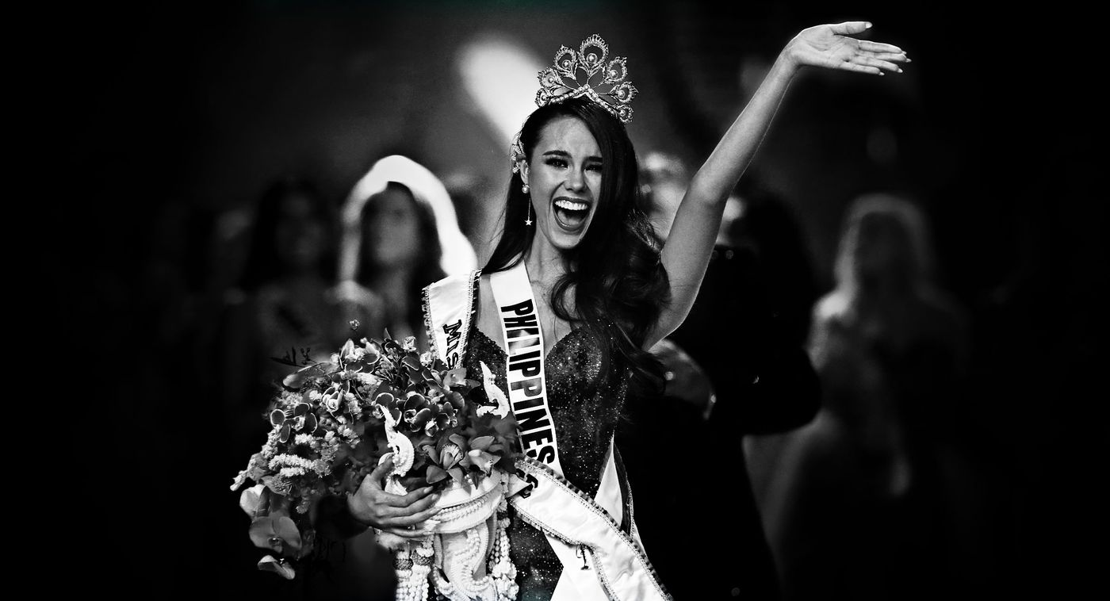
What is a Beauty Pageant?
It is a competition traditionally focused on judging and ranking the physical attributes of the contestants
Some popular beauty pageants include Miss World, Miss Universe, Miss International, and Miss Earth

Slide 3
The Pros of Beauty Pageants
Skill Development
Public Speaking
Charitable Endeavors
Cultural Exchange
Personal Accomplishment

Slide 4
The Cons of Beauty Pageants
Objectifies/Sexualizes Young Women
Body Dysmorphia
Toxic Work Place
Exploitation
Eating Disorders
Promotes Stereotypes

Slide 5
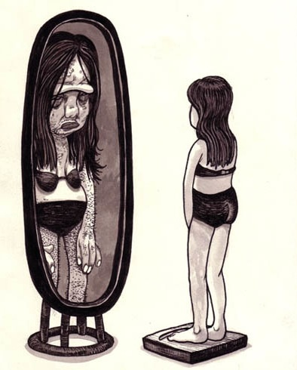
How do Beauty Pageants affect a Women’s Self-esteem
It primarily focuses on a woman’s appearance
They become victims of public body shaming
They spend hours in front of mirrors trying to fit into unrealistic beauty standards
These contests have eligibility restrictions on age, marriage, and pregnancy

Slide 6
Conclusion and Call to Action
Promote diverse beauty standards that celebrate various body types, ethnicities, and appearances
Teach individuals, especially young women, to critically analyze media messages and question narrow beauty standards
Celebrate media that showcases women's achievements, talents, and contributions beyond physical appearance
Be an advocate for change and challenge harmful beauty norms whenever possible

Slide 7
Thank You

